Slide 1
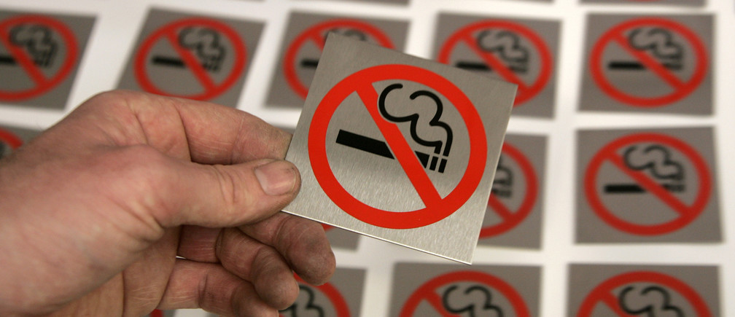
Latin America Tobacco Control
Leadership Program
Group:________

Slide 2
A Shared Vision for Tobacco Control
Where do you want to go?
(Insert vision narrative here)
(Insert vision picture here)

Slide 3
Where are you now?
(Current Situation)
(Summarize current situation here in 5 bullet points or less.)
What area of tobacco control do you need to focus on first, to start the process of change?
__________________________________
3

Slide 4
Why is there a difference?
The Spidergram
Area of TC: ______________
(Insert photo of your spidergram here)
Key constraint – the “weakest leg” (PRIORITY):
Specific problem related to the key constraint or barrier:

Slide 5
Why is there a difference?
Root Cause Analysis – The Fishbone
(Insert photo of fishbone/root cause analysis here. Indicate the key constraint and specific problem as the head of the fish.)
Key Constraint/Weakest leg (Priority):
(Insert photo of fishbone/root cause analysis here.)
Specific problem:
Which ROOT CAUSE will you act on first?

Slide 6
What do we need to change?
Strategic Move
What action will you take to address the root cause? Summarize your strategy to address the root cause of your TC spider’s “weakest leg” in a brief statement:

Slide 7
Who is your intended audience?
Stakeholder Mapping
(Insert photo of your stakeholder map here.)
Who is your critical stakeholder audience? Describe a representative member of that audience.

Slide 8
Your selected audience
Who is your primary stakeholder audience?
What do you want him/her/them to do?
What will move them to act and do what you want? Identify the key benefit for your audience.
How can you reach them? What other communication channels can you use?
How will you know if your advocacy message to your selected audience has been successful?

Slide 9
Share your communication strategy with us, as if we were your selected audience. Be creative. Be brief. No more than 3 minutes/5 slides, using the photos from your Photovoice.

